Slide 1
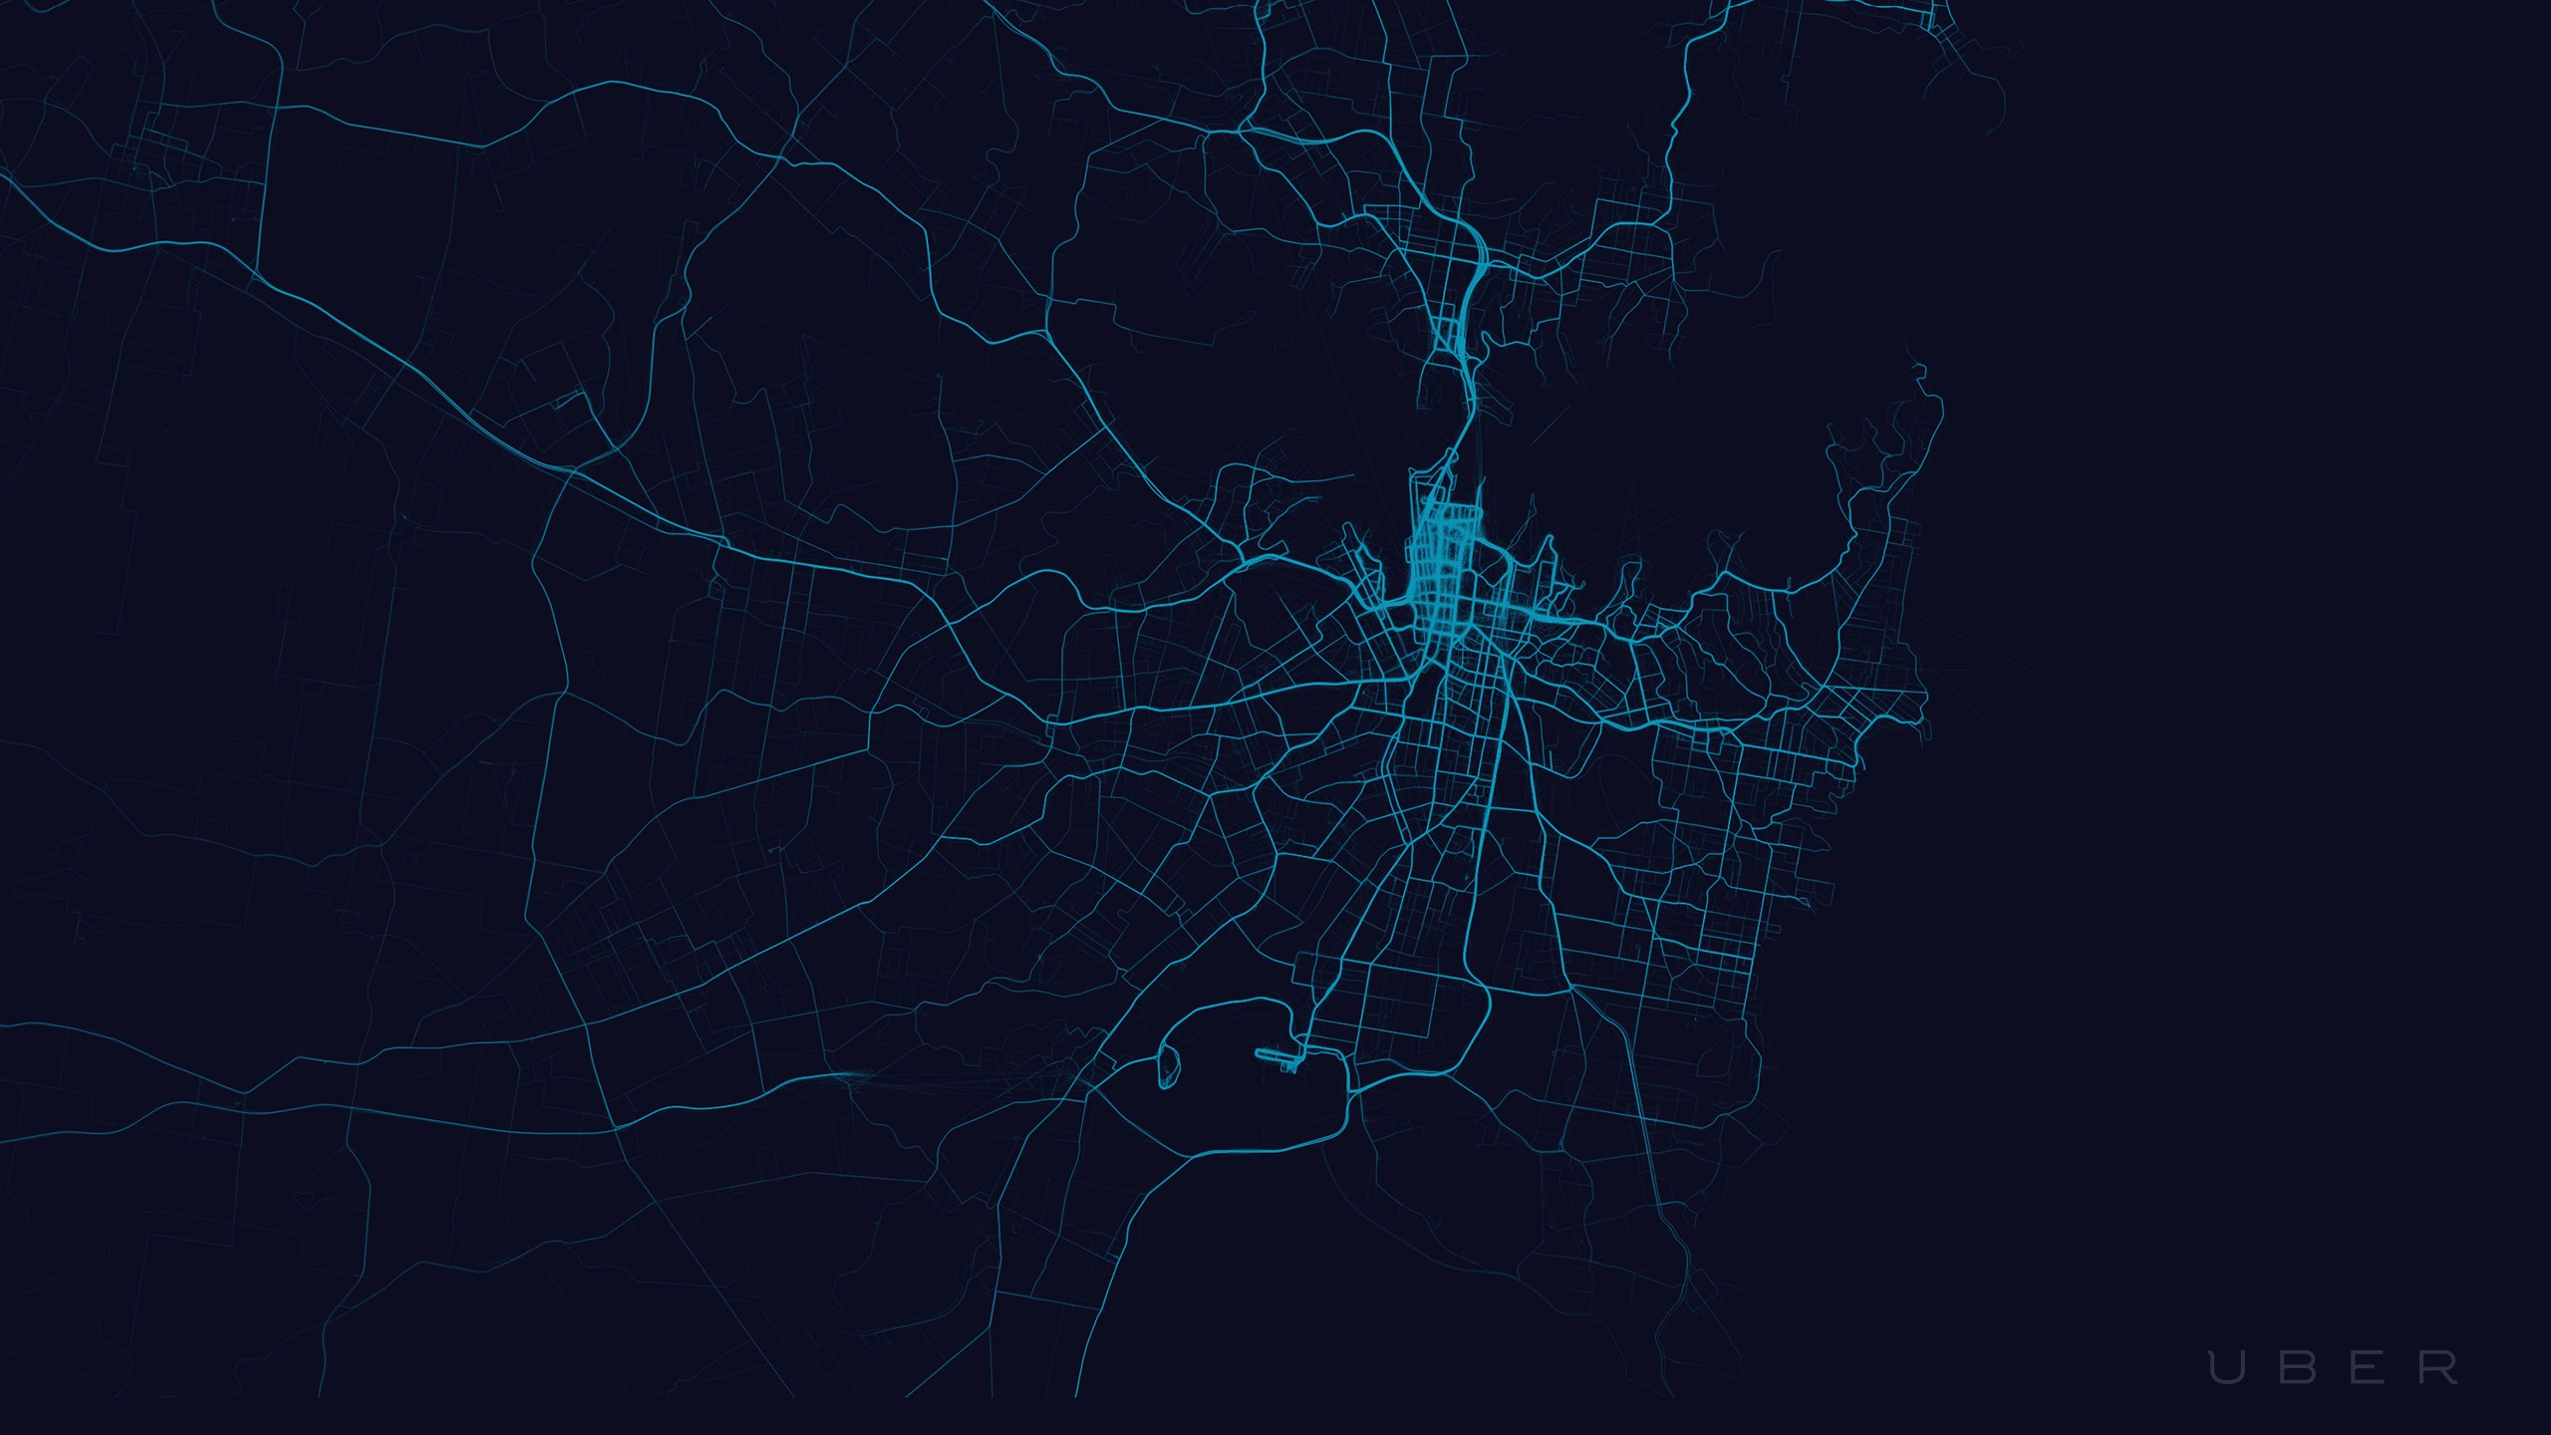
TRUCK-24
A NAME OF TRUST
Team :
SHEKHAR SAHU
AKSHATT PARASHAR
ADITYA RAUSHAN
NISHANT SHARMA
ISHAAN HEMRAJANI

Slide 2
WHY TRUCKS24 ?
The trucking sector should be driven by speed and at promising time with sustainability , safety , security and supply.
Since packers and movers industry is highly disjoint and opaque from ages, this is more than $150 Billion dollar industry in India is infiltrated with technology and there are no standards needed to start this business.
Today, most customers are unfamiliar with the standard moving process and safety. This lack of knowledge could potentially cost them more money and stress than imagined.
We must take care of over rule of the trucks and transportation industry i.e :
Overloading,
Exceeding speed limits,
Violating other traffic and commercial rules that causes road damages.
And mostly we care for :
Safety,
Pollutions,
Damage to roads.

Slide 3
TECHNOLOGIES USED :-
MACHINE LEARNING.
HDFS.
MAP-RED.
ANSIBLE.
DOCKER.
Socket Programming.
Computer Vision.

Slide 4
MACHINE LEARNING
PYTHON
PROGRAMME
RESULT WITH 90% Accuracy
USER
INPUT
PREDICTION
INPUT:
MODULES:
OUTPUT:
1.DISTANCE
1. pandas
2. sklearn
1. PRICE
2.TYPE OF VEHICLE
3.TYPE OF HOUSE
4.TYPE OF LOAD

Slide 5
Hadoop Distributed File System
Client
Name Node
Job Tracker
Data node
&
Task Tracker
1
Data node
&
Task Tracker
2
Data node
&
Task Tracker
3

Slide 6
FUTURE SCOPE
ANDROID AND IOS APP
FOR
TRUCK 24
ANDROID AND IOS APP
FOR
TRUCK 24
LIVE MONITORING OF TRUCKS THROUGH GPS AND GOOGLE API
ONE CLICK AND HASSLE FREE TRANSPORT
SERVICE ASSURANCE
ONE CLICK AND HASSLE FREE TRANSPORT
BEST FREIGHT LOGISTIC FOR BETTER SERVICE
SERVICE ASSURANCE
BEST FREIGHT LOGISTIC FOR BETTER SERVICE

Slide 7
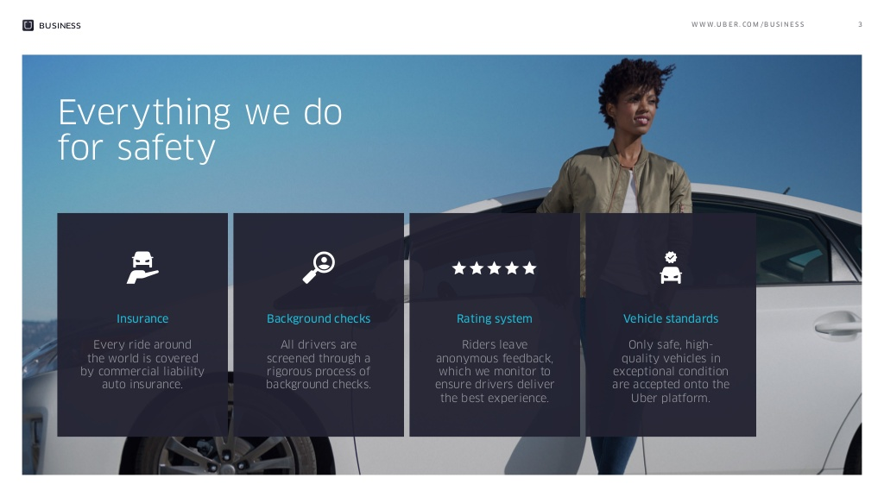

Slide 8
Special Thanks To : VIMAL DAGA SIR
THANK YOU

